Slide 1
Employee Churn Analysis Project
SDA1058-Atheer
SDA1046-Sarah
SDA1048-Salma
SDA1054-Aeshah
SDA1043-Afnan
SDA-1047-Husam
SDA1042-Rahaf
SDA1087-Waad
SDA1055-Marwah

Slide 2
Project Overview
Objective:
Identify the root causes of employee churn.
Develop targeted strategies based on the identified patterns to reduce employee churn.
Why is it Important?
Cost Reduction
Retention of Talent
Productivity Improvement
Efficiency in Recruitment

Slide 3
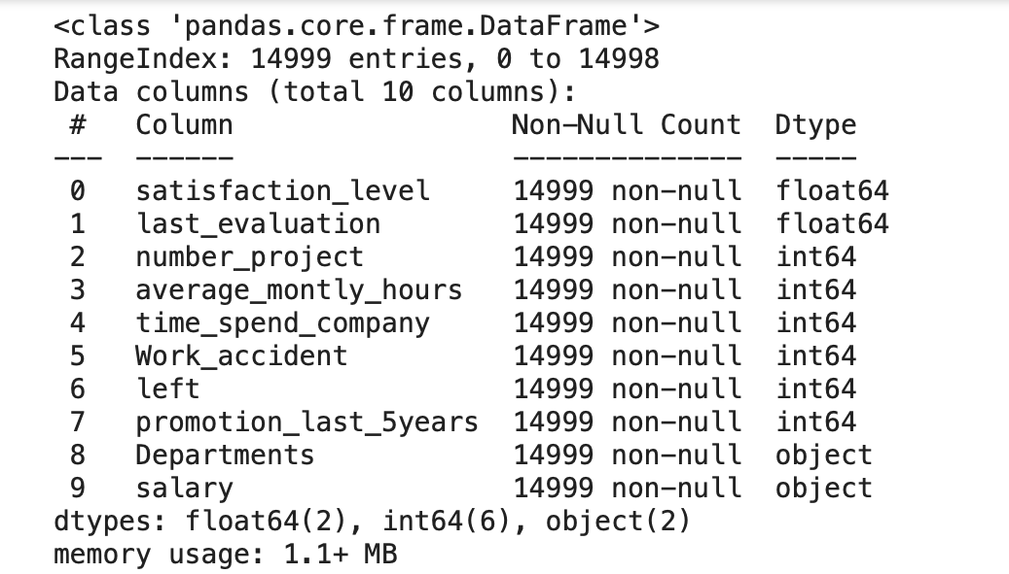
Data Exploration
In this project, we have the HR data of a company. A study is requested from us to predict which employee will churn by using this data.
The HR dataset has 14,999 samples. In the given dataset, we have two types of employees one who stayed and another who left the company.

Slide 4
Project Construction
01
Exploratory Data Analysis (EDA)
02
Cluster Analysis
03
Predictive Model Building
04
Model Deployment

Slide 5
01
Exploratory Data Analysis (EDA)

Slide 6
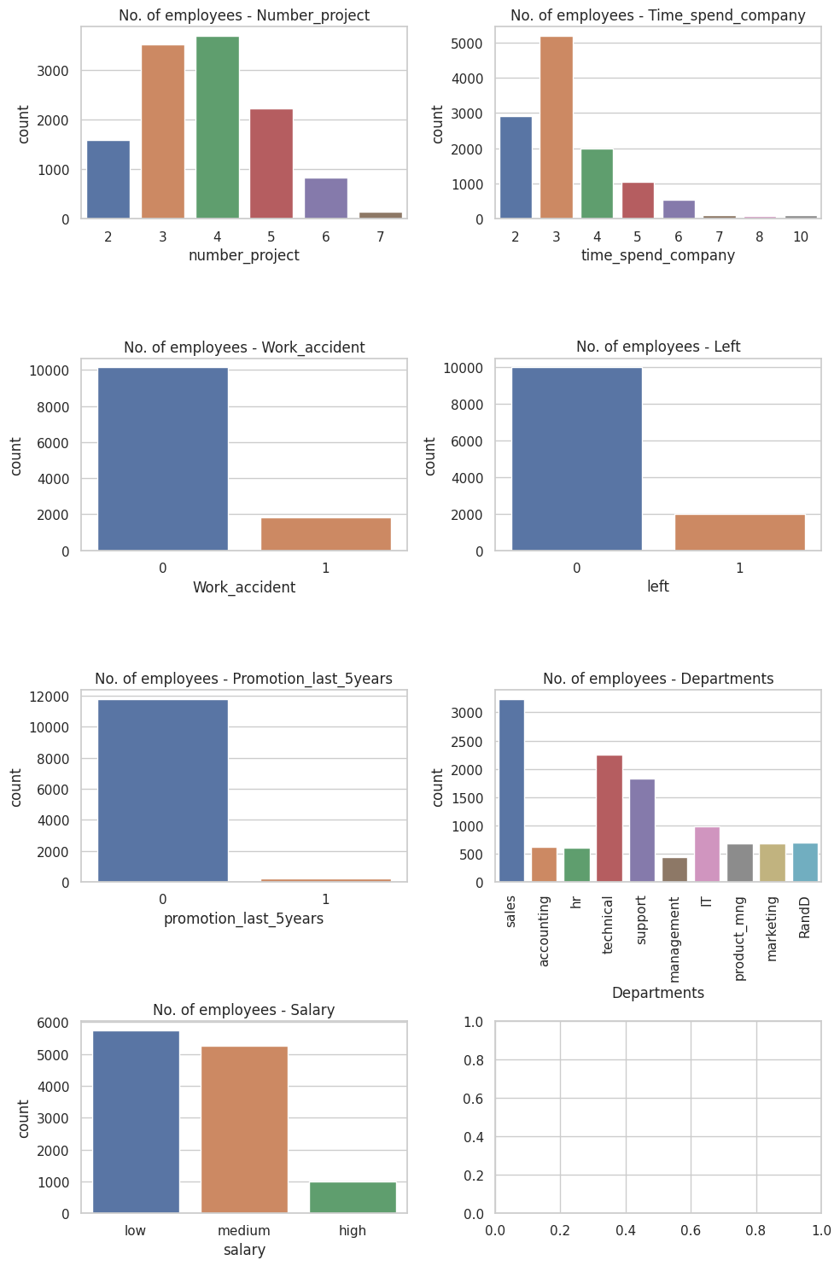
Exploratory Data Analysis (EDA)
-Most of the employees have been with the
company for two to three years.
-Most employees work on three to
five projects.
- Number of employee who stayed is higher
Than those who left the company

Slide 7
Exploratory Data Analysis (EDA)
Here we can observe that the "Sales" and “technical and Support" departments have a moderate number of employees.
Must employees did not receive promotion last 5 years
Most employees have low to medium salary

Slide 8
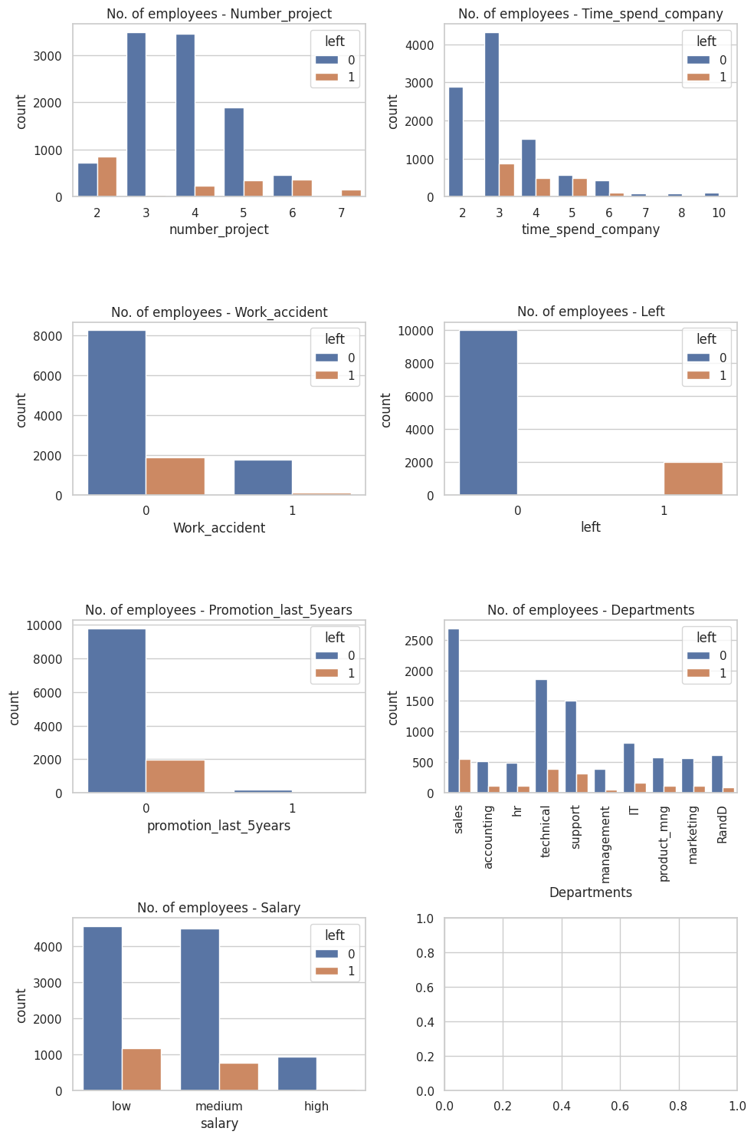
Exploratory Data Analysis (EDA)
Left vs other columns
-Employees usually leave the company after 2 years & employees who have spent more than 7 years in the company tend to exhibit more loyalty and are more likely to stay
-We can observe that employees who worked on an average number of projects 3-4 tend to stay with the company.
-There is no strong relation between work accidents and employees leaving the company.

Slide 9
Exploratory Data Analysis (EDA)
-Salary and left column are slightly correlated.
-There is a slight correlation between promotion and the left column. people can leave if they did not get promoted in the last 5 years
-Employees usually leave the company after 2 years & employees who have spent more than 7 years in the company tend to exhibit more loyalty and are more likely to stay
-There is no strong relation between work accidents and employees leaving the company.
-some departments like sales & technical have higher number of employees leaving the company.
-We can observe that employees who worked on an average number of projects 3-4 tend to stay with the company.
-Salary and left column are slightly correlated.
-There is a slight correlation between promotion and the left column. people can leave if they did not get promoted in the last 5 years
-some departments like sales & technical have higher number of employees leaving the company.

Slide 10
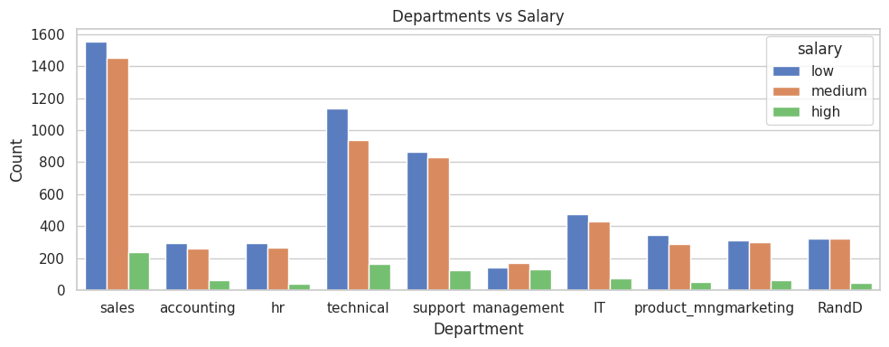
Exploratory Data Analysis (EDA)
The departments with low salaries have the highest number of employees leaving the company.

Slide 11
02
Cluster Analysis

Slide 12
Cluster Analysis
Clustering is the task of dividing the data points into a number of groups such that data points in the same groups are more similar to other data points in the same group and dissimilar to the data points in other groups.
It is basically a collection of objects on the basis of similarity and dissimilarity between them.
When applying clustering, it is important to consider the number of clusters (K) to be formed. In this case, the clustering algorithm is configured with 3 and 4 clusters.

Slide 13
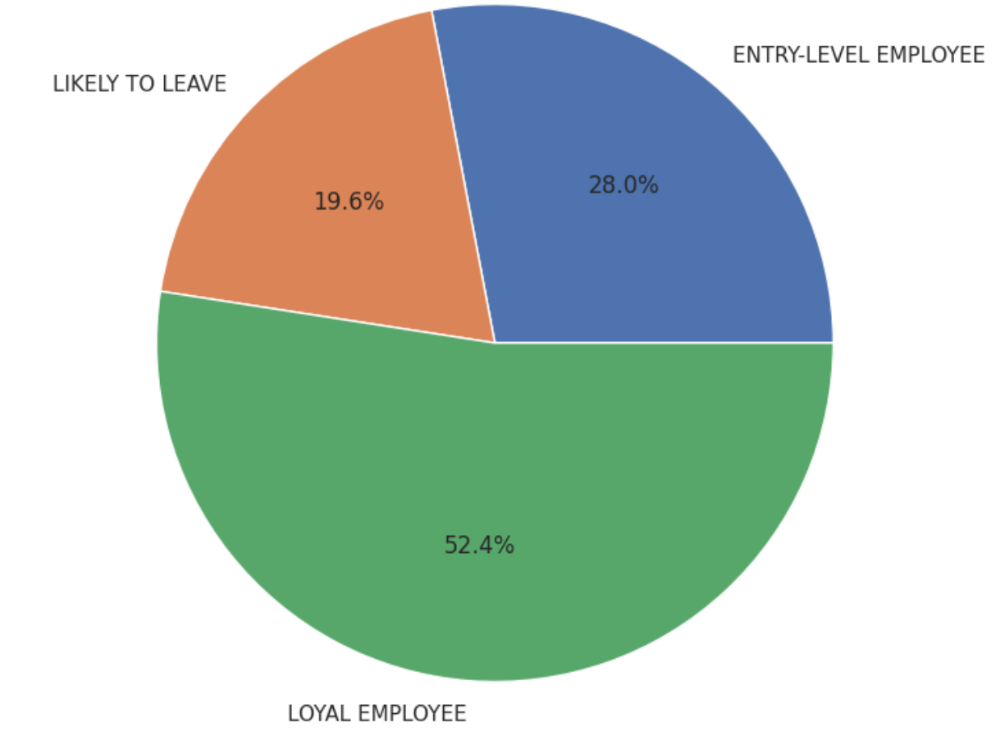
Cluster Analysis
Clustering Results with 3 clusters :
Cluster 1 represents 52.4% of LOYAL EMPLOYEE.
Cluster 2 represents 28.0% of ENTRY-LEVEL EMPLOYEE.
Cluster 3 represents 19.6% of LIKELY TO LEAVE.

Slide 14
03
Predictive Model Building

Slide 15
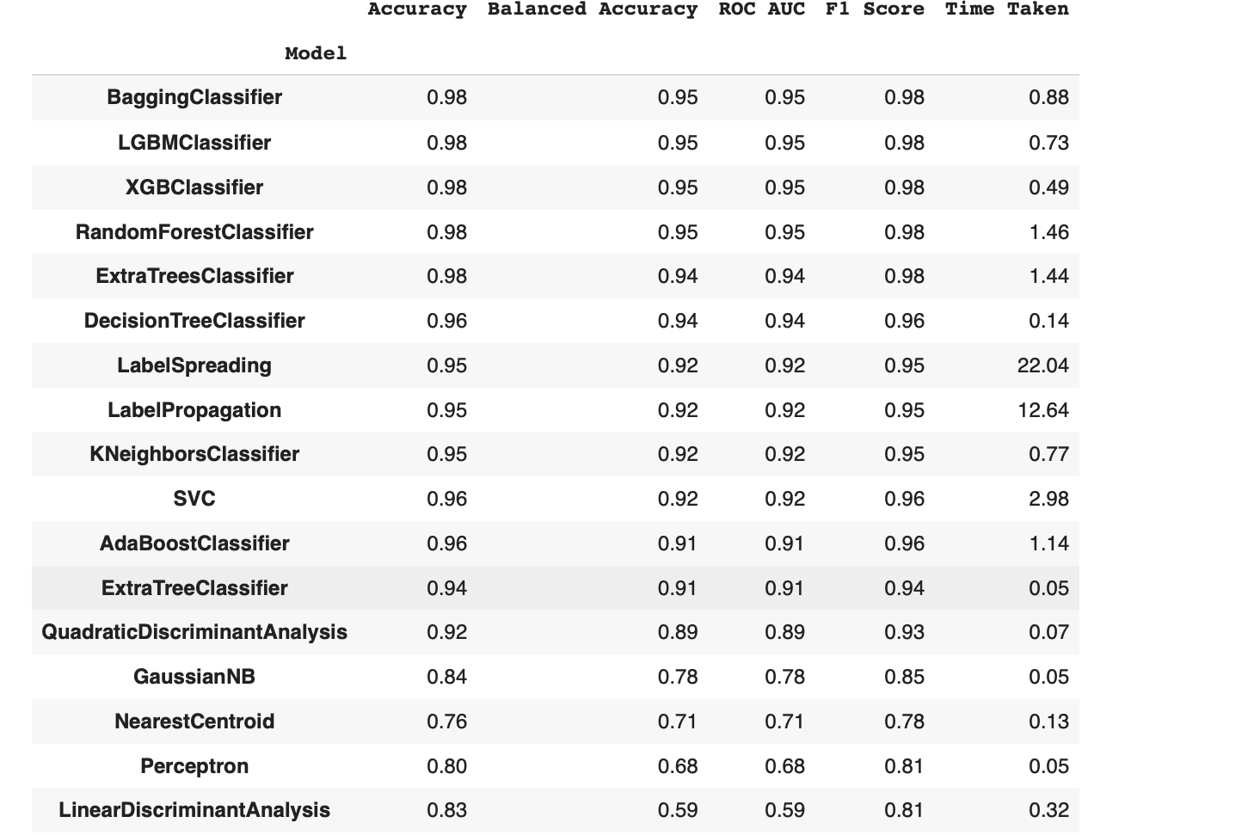
Predictive Model Building
Choose the best ML model using LazyPredcit

Slide 16
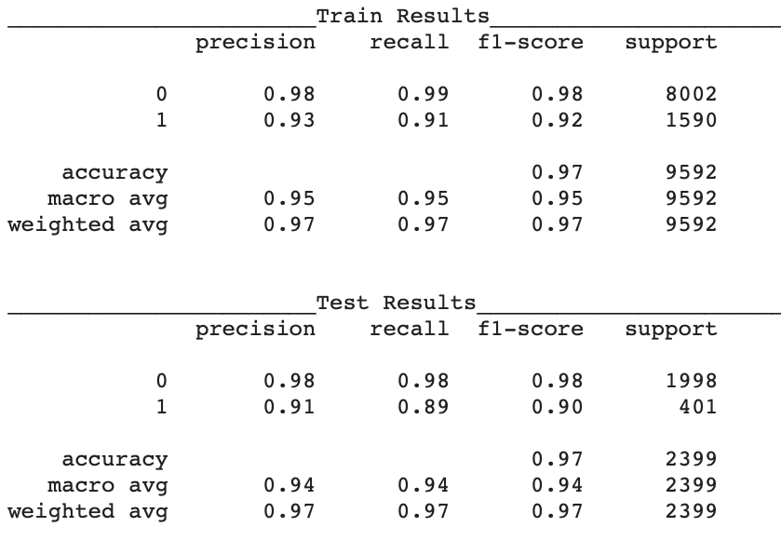
Predictive Model Building
1. Support Vector Classifier (SVC)
Support Vector Machine (SVM) is a supervised machine learning algorithm used for both classification and regression.
The main objective of the SVM algorithm is to find the optimal hyperplane in an N-dimensional space that can separate the data points in different classes in the feature space.

Slide 17
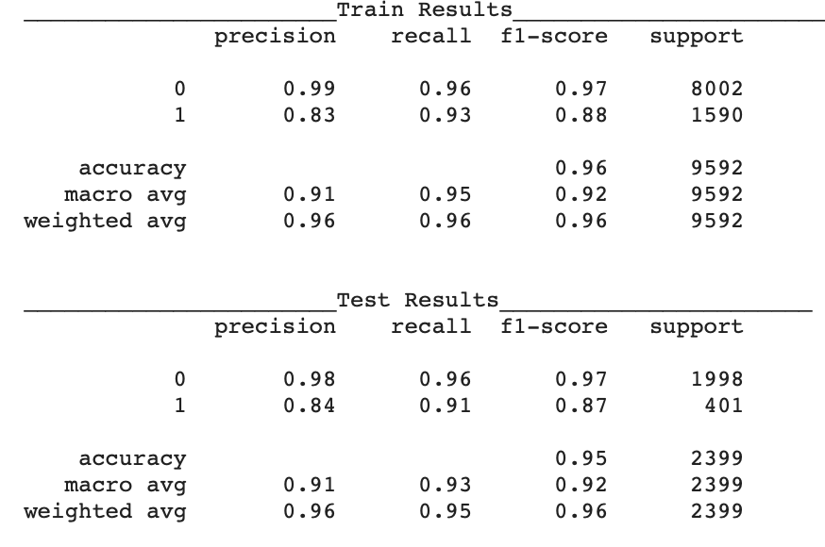
Predictive Model Building
2. Random forest (RF)
A random forest is an ensemble learning method that combines the predictions from multiple decision trees to produce a more accurate and stable prediction.
It is a type of supervised learning algorithm that can be used for both classification and regression tasks.

Slide 18
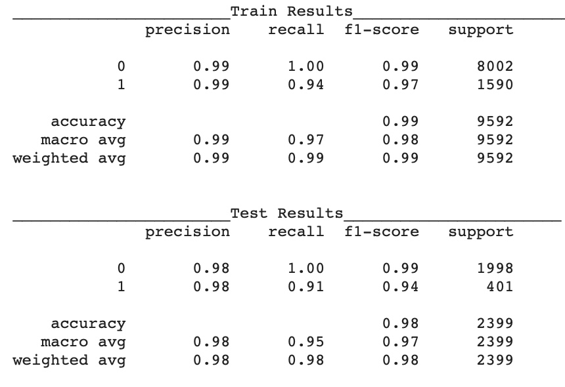
Predictive Model Building
3. XGB Boost
XGBoost is an optimized distributed gradient boosting library designed for efficient and scalable training of machine learning models.
It is an ensemble learning method that combines the predictions of multiple weak models to produce a stronger prediction. and it has become one of the most popular and widely used machine learning algorithms.

Slide 19
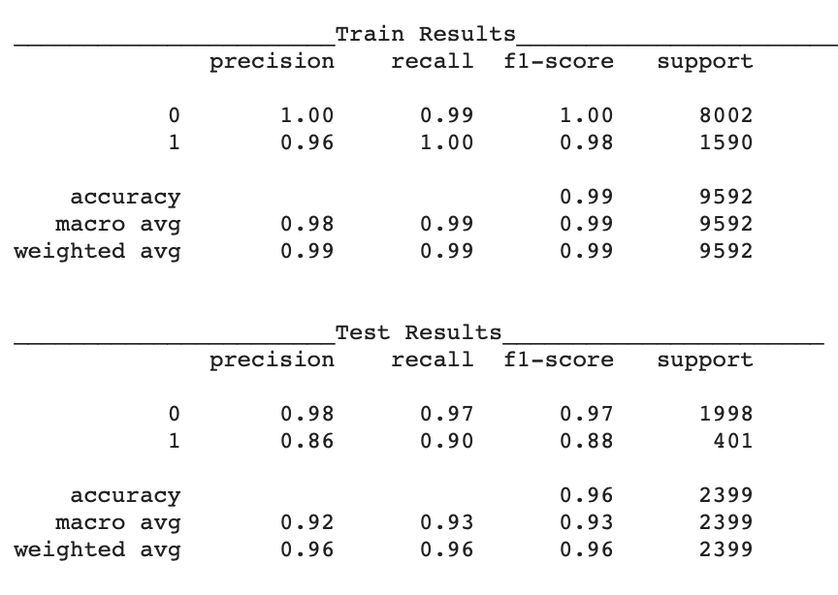
Predictive Model Building
4. Deep Learning
Deep learning is a subfield of machine learning that utilizes neural networks with multiple layers to automatically learn complex patterns and representations from data.
This allows for advanced capabilities in tasks such as image recognition, natural language processing, and complex decision-making.

Slide 20
04
Model Deployment

Slide 21


Slide 22
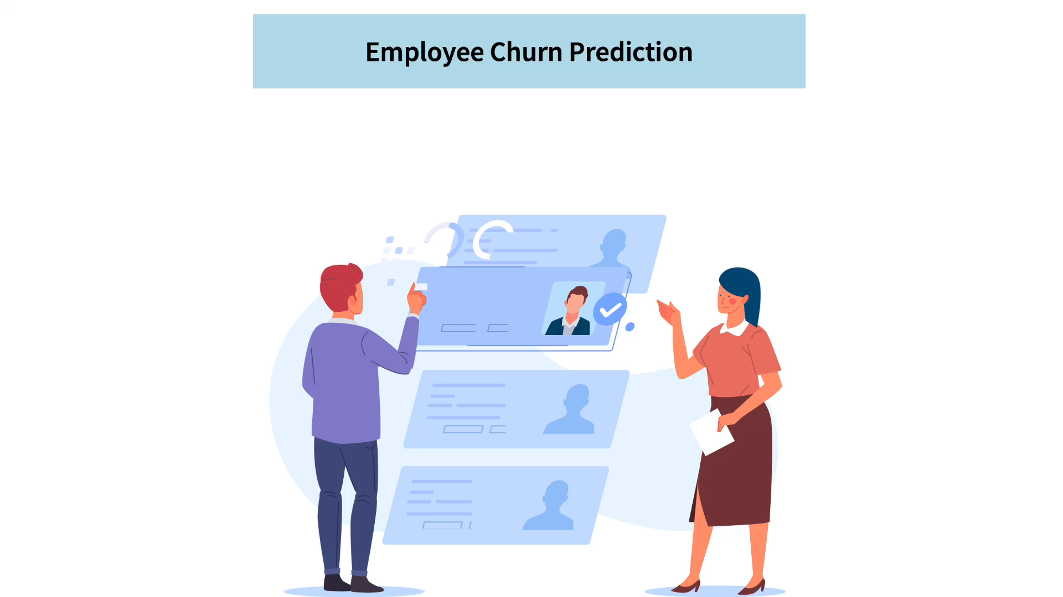

Slide 23
Conclusion

Slide 24
After trying different ML and DL classifiers we finally deployed XGB boost model which gave us the best classification results

